Slide 1
AKILAN BIMBY ANNADURAI

Slide 2
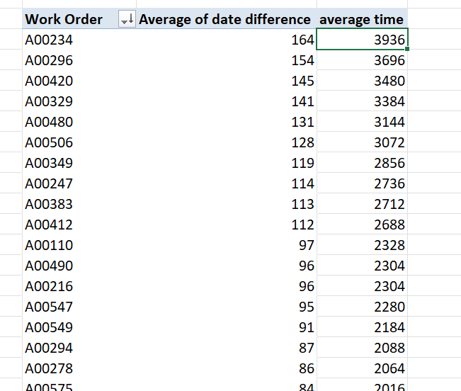
1.What is the average lead time between the request date and completion date for all workers
The average lead time between the request date and the completion date are 3936
Pivot is used

Slide 3
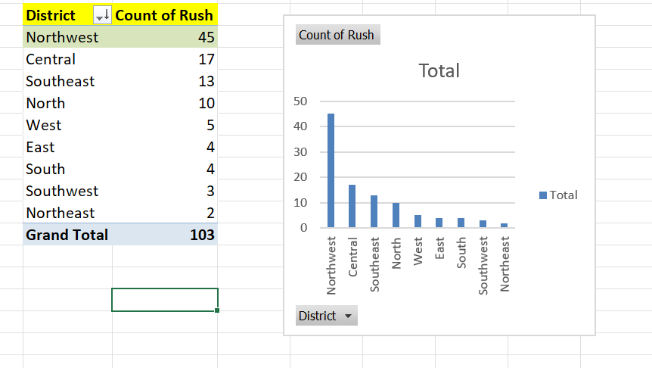
2.Which district has the highest number of rush jobs?
The NORTHWEST district has the highest rush jobs
Pivot is used

Slide 4
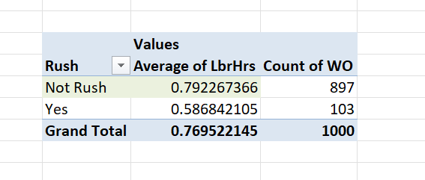
3.How does the average labour hours differ between rush and non-rush jobs
the average labour hours differ between rush and non-rush jobs is 0.7695
Pivot is used

Slide 5
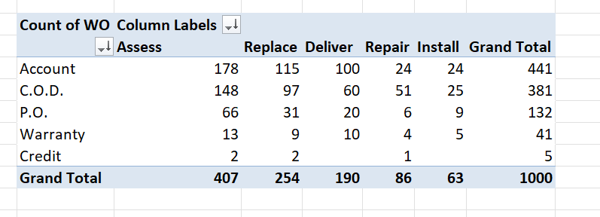
4.What is the distribution of payment types across different services?
For assess it is 178 ,And is the highest of them all
Pivot is used

Slide 6
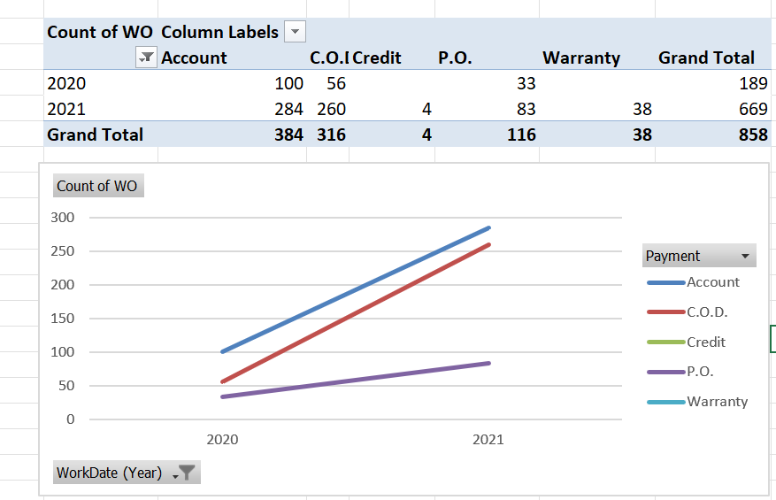
5.Are there any trends in the distribution of payment types over time
Yes there is a trends in the distribution of payment types over time,it gradually increases.
Pivot is used

Slide 7
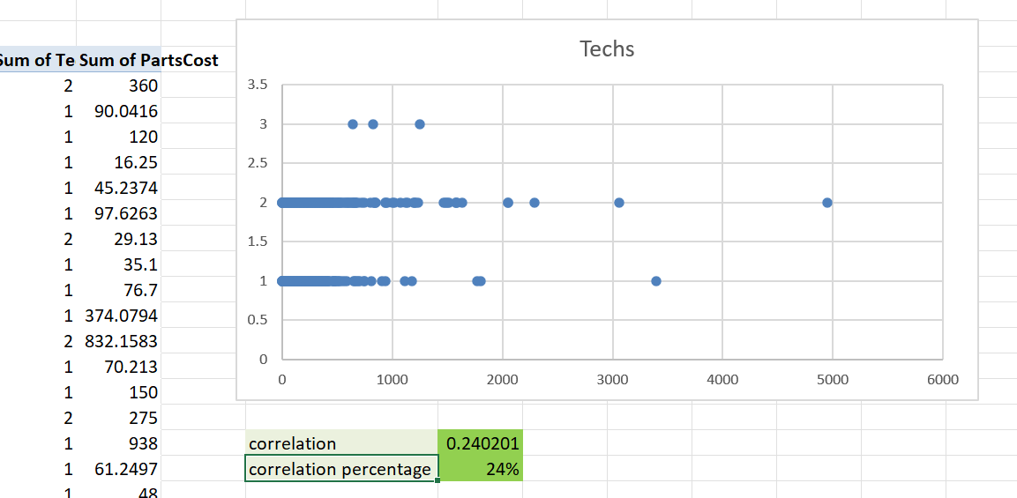
6.Is there a relationship between the number of technicians required and the cost of parts
No there is not that much relationship between the number of technicians required and the cost of parts

Slide 8
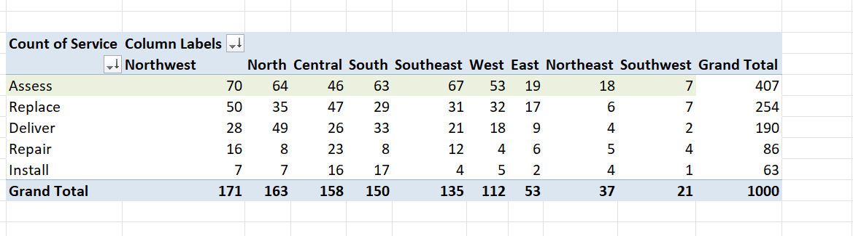
7.What is the most common type of service requested in each district?
Asses is the most common type of service requested in each district

Slide 9
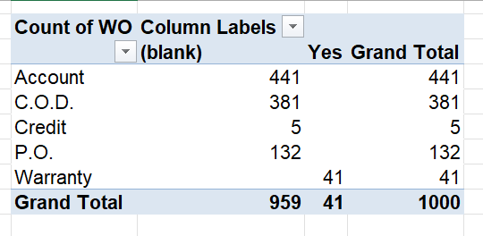
8.Is there any difference in the distribution of payment types for work orders with warranty labour compared to those without?
With warranty there is only 41 and without warranty there are 959.
Pivot is Used.

Slide 10
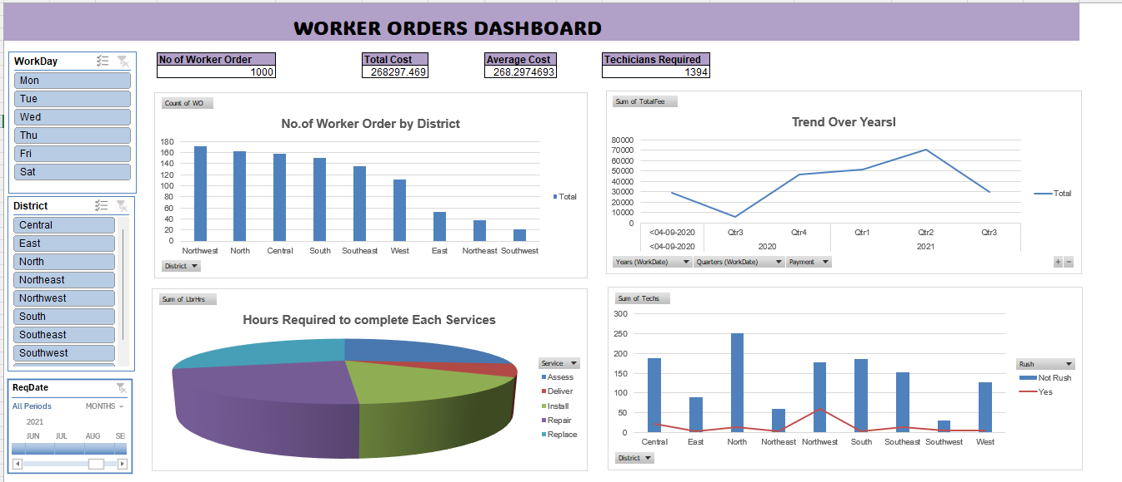
dashboard

